Slide 1
Secure PHP and MySQL
Prof. Charles Kaplan
Farmingdale State College

Slide 2
Agenda
Threats
Handling Input Data
Storing Data
Website Construction
Sessions
Website Infrastructure
Summary

Slide 3
Disclaimer
This presentation does NOT cover risks involved with websites that accept financial payments
Recommendation: Integrate PayPal’s (or similar) shopping cart and payment services into your website to avoid having sensitive (and regulated) customer financial data on your website
There are many ways to implement website security, not all methods are covered in this presentation

Slide 4
Background
Started career as a mainframe programmer & database specialist
After 5 years went to IBM in Tech Support and Sales
In 2005, 25 years since I last programmed, I wanted to create a website for my hobby
Asked Walden Leverich for advice => PHP and MySQL
Read textbook on flight to CA & designed website on flight home
Coded website in a week, 3 scripts, and 3 weeks for data entry
Website continually updated and added new techniques
Average 2 websites a year since then

Slide 5
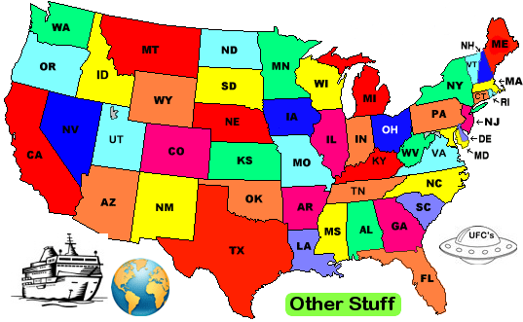
The ChipGuide

Slide 6
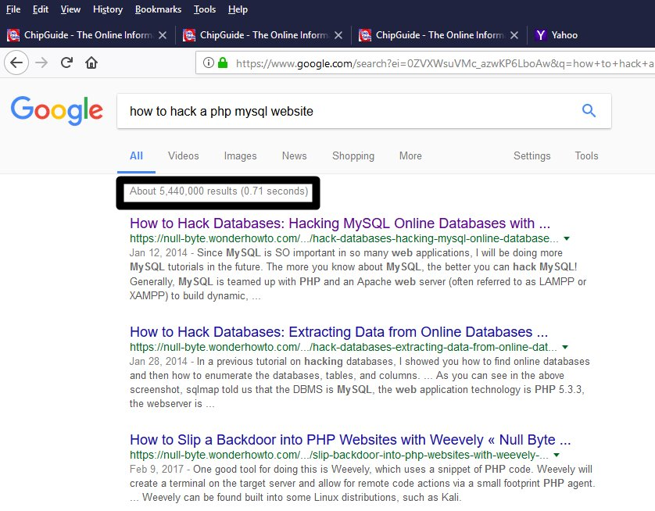

Slide 7
Threats
Cross site scripting (XSS)
SQL Injection
Directory traversal (path injection)
Command injection
Code injection
Cross site request forgery (XSRF/CSRF)
Session hijacking
Remote file inclusion
Accidents/Disasters

Slide 8


Who Will be Hacked First?

Slide 9
Website Access
CLIENT USER PURPOSE
Browser End Users Use the website
FTP Developer Upload Code & Other files
Telnet Developer Maintain Website
Control Panel Developer Maintain Website
FTP, Telnet and Control Panel access should only be SECURE using unpredictable USERID’s and STRONG PASSWORD’s

Slide 10
PHP Vulnerabilities
PHP is an interpretive language – code is “compiled” during execution. It is possible to alter a program while it is executing.
$id = $_GET[‘id’];
$query = “SELECT name, password FROM profiles WHERE id = ‘$id’;
What if: http://website/mypgm.php?id=1’ OR ‘1
$query = “SELECT name, password FROM profiles WHERE id =‘1’ OR ‘1’”;

Slide 11
HANDLING
INPUT DATA

Slide 12
Client Input
Sources of Client Input
HTML Form Data
URL paramters
Cookies
Do not trust any client input
Sanitize Input
Validate input

Slide 13
Clean Your Input
Convert quotes to ASCII equivalent
  $column = htmlentities($column, ENT_QUOTES);
Remove HTML tags
  $column = strip_tags($column);
Trim leading and trailing blanks
  $column = trim($column);
Clean Function – Perform on ALL input
  function clean($string)
  return(htmlentities(strip_tags(trim($string)), ENT_QUOTES));

Slide 14
Cleanse/Normalize Input Function
function cleanse_input($phrase, $format) {
$phrase = filter_var($phrase, FILTER_SANITIZE_STRING);
$format = trim(strtolower($format));
$format_length = strlen($format);
for ($i = 0; $i < $format_length; $i++) {
$letter = substr($format, $i, 1);
switch($letter) {
case "a": $phrase = preg_replace("/[^a-zA-Z ]+/", "", $phrase); break; // Remove any non-alphabetic characters
case "e": $phrase = ltrim($phrase); break; // Left Trim
case "f": $phrase = ucfirst($phrase); break; // Capitalize First Word
case "i": $phrase = preg_replace('/\s+/', ' ', $phrase); break; // Internal Trim
case "l": $phrase = strtolower($phrase); break; // Lower Case
case "n": $phrase = preg_replace("/[^0-9.]+/", "", $phrase); break; // Remove any non-numeric characters
case "r": $phrase = rtrim($phrase); break; // Right Trim
case "s": $phrase = strip_tags($phrase); break; // Remove HTML
case "t": $phrase = trim($phrase); break; // Trim
case "u": $phrase = strtoupper($phrase); break; // Upper Case
case "w": $phrase = ucwords($phrase); break; // Capitalize Words
default:
}
}
return($phrase);
}

Slide 15
Input Validation – filter_var Function
filter_var($string, FILTER_VALIDATE_xxxxxxxx)
FILTER_VALIDATE_BOOLEAN
FILTER_VALIDATE_EMAIL
FILTER_VALIDATE_FLOAT
FILTER_VALIDATE_INT
FILTER_VALIDATE_IP
FILTER_VALIDATE_MAC
FILTER_VALIDATE_REGEXP
FILTER_VALIDATE_URL

Slide 16
Input Validation
Zip Code preg_match('/^[0-9]{5}([- ]?[0-9]{4})?$/', $zipcode) Telephone preg_match("/^[0-9]{3}-[0-9]{4}-[0-9]{4}$/", $phone)
Name preg_match("/^[a-zA-Z'-]+$/", $name) // No spaces
preg_match("/^[a-zA-Z’- ]+$/", $name) // Spaces
State in_array($state, $states) // Need $states array
Date $date = explode('/’, $input_date); // 12/31/2017
checkdate($date[0], $date[1], $date[2]) // m, d, y
Address Use internet service (subscription required)

Slide 17
Validate URL
function validate_url($url) {
$return = FALSE;
if (filter_var($url, FILTER_VALIDATE_URL)) {
$headers = get_headers($url);
if (strpos($headers[0],"200")) $return = TRUE;
}
return($return);
}

Slide 18
Input Validation – Drop Downs
Even input from Dropdown’s must be validated
Build Array with Dropdown Elements
$query = “SELECT DISTINCT column FROM table ORDER BY column”;
$result = mysqli_query($query);
while (list($col) = mysqli_fetch_row($result)) $columns[] = $col;
Output Dropdown
echo “<select name=‘column’>”;
foreach ($columns AS $value) echo “<option>$value</option>”;
echo “</select>”;
Input Verification
if (isset($_POST[‘column’])) $column = $_POST[‘column’]; else $column = NULL;
If (!in_array($column, $columns)) $msg = “Invalid Data”;

Slide 19
File Uploads

Slide 20
File Upload Process
Web Server
Temporary
Storage
Permanent
Storage
(Protected)
File
File
HTML
FORM
<INPUT
Type=‘FILE’>
File Info
Move File
Command
PHP
Script
Database
Table
Form
Input
File Link

Slide 21
File Uploads
You do not want to allow uploading executable code which can later be executed !!! (http://website.com/uploads/mypgm.exe)
Permit only certain file types, ie. images
Limit file size
Place uploaded files in a protected subdirectory
Filename is primary key (+ suffix if multiples) of row in table related to the file upload
File Extension is from original file
Validate image files - getimagesize()

Slide 22
File Upload Function
<?php
// File Upload Function
// Written by Charles Kaplan, November 2015
// INPUTS
// $input - HTML FORM INPUT element name for uploaded file <input type=‘file’ name=‘image’>
// $dir - Directory to put uploaded file
// $filename - Filename for uploaded file
// $extns - Valid extensions for uploaded file (array)
// $maxsize - Maximum file size of uploaded file
// Outputs
// 1st Parameter - Error Code, 0 = Success, > 0 = Failure
// 2nd Parameter – Full filename ($dir/$filename.$ext) of the saved file or Error Message

Slide 23
File Upload Function, continued
function upload($input, $dir, $file, $extns, $maxsize) {
$msg = NULL; $rc = 0;
if (isset($_FILES[$input]['tmp_name'])) AND (is_uploaded_file($_FILES[$input]['tmp_name'])) {
$fn = $_FILES[$input]['name’];
$ext = trim(strtolower(strrchr($fn, ".")));
if (!in_array($ext, $extns)) {$msg = "Invalid File Type"; $rc = 10;}
if ($_FILES[$input]['size'] > $maxsize)
{$msg = "Uploaded file size [" . $_FILES[$input]['size'] . "] exceeds limit [$maxsize]"; $rc = 11;}
if (substr($dir,-1,1) != "/") $dir .= "/";
$savefile = $dir . strtolower($file) . $ext;
if ($rc == 0) {
$result = move_uploaded_file($_FILES[$input]['tmp_name'], $savefile);
if ($result > 1) {$msg = "Move Uploaded File Failed"; $rc = $result;} } }
else {$msg = "No Uploaded File"; $rc = 12;} }
if ($rc == 0) return(array($rc, $savefile)); else return(array($rc, $msg));
}
?>

Slide 24
Storing Data

Slide 25
Encrypting Sensitive Data
Passwords and Other Sensitive Data
password_hash
  $encypted_password = password_hash($password);
password_verify
  If (password_verify($password, $encrypted_password))
    echo “Password is valid”;
    else echo “Invalid Password”;
Form Input
  <input type=‘password’ name=‘pswd’> // Obscures text

Slide 26
MySQL Prepared Statements
Using prepared statements with placeholders for parameter values has the following benefits:
Less overhead for parsing the statement each time it is executed. Typically, database applications process large volumes of almost-identical statements, with only changes to literal or variable values in clauses such as WHERE for queries and deletes, SET for updates, and VALUES for inserts.
Protection against SQL injection attacks. The parameter values can contain unescaped SQL quote and delimiter characters.

Slide 27
Website Construction

Slide 28
Website Construction
Typical Website
homepage.php
include(‘session.php’);
include(‘header.php’);
include(‘navbar.php’);
echo “This is the website’s Home Page”;
include(‘footer.php’);
webpage.php
include(‘session.php’);
include(‘header.php’);
include(‘navbar.php’);
echo “This is where content goes for all other webpages”;
include(‘footer.php’);

Slide 29
Website Construction
Single Page Websites - All “webpages” are INCLUDES
website.php
include(‘session.php’);
$p = $_GET[‘p’];
$page = “page$p.php”;
If (!exist[$page])
$page=“page0.php”;
$landing = TRUE;
include(‘header.php’);
include(‘navbar.php’);
include($page);
include(‘footer.php’);
page0.php
echo “This is the website’s Home Page”;
page1.php
if (!isset($landing)) {
include(‘page0.php’);
exit;
}
echo “This is where content goes for all other webpages”;

Slide 30
Website Construction – Directories
index.php
include(‘code/website.php’);
Protected Sub-Directories
backups/
code/
images/
uploads/
…
Root Directory
Unprotected – Public Access
code/
website.php
session.php
page0.php
page1.php
…
page99.php
Sub-Directory
Protected – Internal Access

Slide 31
HTTPS – Secured Sockets
HTTPS provides encrypted web traffic
Many browsers now require HTTPS for logons
This is a website option, no changes in PHP code are needed
Web provider provides instructions for implementation
Certificate is needed ($’s ?)
Need to re-route HTTP traffic to HTTPS
    <?php // index.php
    if ($_SERVER['HTTPS']) include(“code/website.php”); // website home page
    else header(“location: https://mywebsite/index.php"); // redirect to HTTPS
    ?>

Slide 32
Sessions

Slide 33
Session Hijacking
A session is established the first time a client makes a request to a webserver via a SESSION_ID. The webserver can maintain data through multiple client requests by association with the SESSION_ID. Sessions allow for conversations to occur in the stateless Internet. It is possible for another client to learn the SESSION_ID and take over the session – Session Hijacking. If a session is hijacked, the hijacker has the same ability as the original client.

Slide 34
Session Hijacking Solution
Establish a new SESSION_ID with each request
session_start();
session_regenerate_id(TRUE);
Additional Session Safety Tips
Associate the session with an IP address
  $_SESSION[‘ip’] = $_SERVER['REMOTE_ADDR’];
  If ($_SESSION[‘ip’] != $_SERVER['REMOTE_ADDR’]) session_destroy();
Timeout Sessions after 5 minutes
  $_SESSION[‘timeout’] = time();
  If (($_SESSION[‘timeout’] + 300) < time()) session_destroy();

Slide 35
Safe SESSION Settings (php.ini)
session.save_handler = files
session.use_cookies = 1
session.cookie_secure = 1
session.use_only_cookies = 1
session.cookie_domain = "example.com"
session.cookie_httponly = 1
session.entropy_length = 32
session.entropy_file = /dev/urandom
session.hash_function = sha256
session.hash_bits_per_character = 5

Slide 36
Website Infrastructure

Slide 37
PHP.INI – Security Configuration
post_max_size=1K
file_uploads = Off // Don’t allow file uploads
upload_max_filesize = 1M // Limit File Upload Size
allow_url_fopen = Off // Don’t allow remote files
allow_url_include = Off // Don’t allow remote includes
post_max_size = 1K // Set to realistic value
open_basedir = "/www/" // Limit PHP access to root & subs
expose_php = Off // Keep PHP hidden
error_reporting = E_ALL // Report all errors in log file
display_errors = Off // Do not show errors
display_startup_errors=Off // Do not show errors
disable_functions = exec, passthru, shell_exec, system, proc_open, popen, curl_exec, curl_multi_exec, parse_ini_file, show_source

Slide 38
Disaster Plan
Written Plan that others can follow
Prepare for the Worst
Understand your web provider’s ability to restore lost or damaged files and data
Periodic offsite backups (use Secure FTP - Filezilla)
Test your ability to recover – you can use your PC (WAMPServer or XAMPP)

Slide 39
Database Backups - DIY
Allows restore of the database without assistance
Daily CRON job that backs up the database @ 3am to a backup directory on my website, filename is DataBaseName_yyyy-mm-dd.sql
Daily backups are kept for 30 days
Monthly backups are kept forever
Use PHPMyAdmin to do a restore
daily_backup.php
$backupfile = "backup/$database_" . date("Y-m-d") . ".sql";
$command = "mysqldump -h $server -u $user --password=$password $database > $backupfile";
system($command);

Slide 40
Summary
Close open doors – Telnet, FTP and Control Panel
Don’t trust any input – cleanse and verify
Minimize exposure of internal resources
Disable dangerous website features when not in use
Construct websites using SECURE techniques
Establish a backup/recovery plan and TEST!

